Slide 1
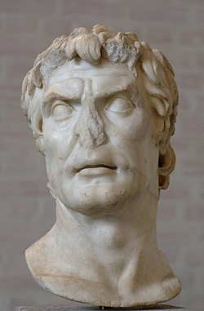
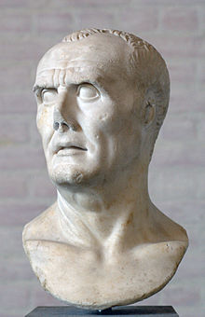
REVISION 1
EST PREPARATION
Week 3, Lesson 4

Slide 2
EST REVISION - Overview
WEEK | Tuesday | Wednesday | Thursday | Friday
3 | X | X | X | Revision 1
4 | Revision 2 | Revision 3 | Revision 4 | Revision 5
5 | EST | Inquiry | Inquiry | Inquiry
6 | Inquiry | Inquiry | Inquiry | Inquiry

Slide 3
Today’s Lesson
Content Revision – key topics
Revision Booklet

Slide 5
Revision
Complete the booklet independently

